Slide 1

Intro to geometry
Nicola Baird

Slide 2


Point, Line, and Plane are Technically Undefined...
UNDEFINED TERM: an expression which is not assigned an interpretation or a value
There are no terms available to define them! The best way to conceptualize undefined terms is to describe them using physical examples!

Slide 3
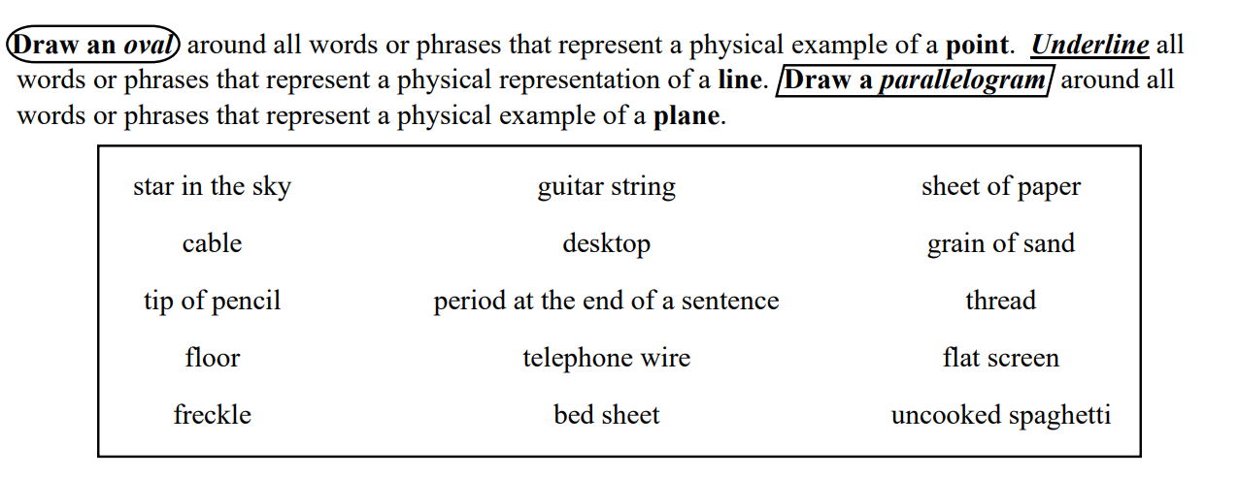
around phrases that represent a point
phrases that represent a line
around all phrases that represent a plane

Slide 4

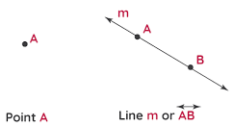
What’s the Point?
A point is represented by a small dot.
Points are named using capital letters.
A Point is a geometric element that has zero dimension (no length, breadth, depth, or height)
A Point indicates a position or location in space—Think of plotting (2,3) on a cartesian plane.

Slide 5
What’s a Line?
It Never Ends!!!!!!!!!!!!!!!!!!
A line has one dimension. Through any two points, there is exactly one line.
It is represented by a straight line with two arrowheads to indicate that the line extends without ending in two directions.

Slide 6
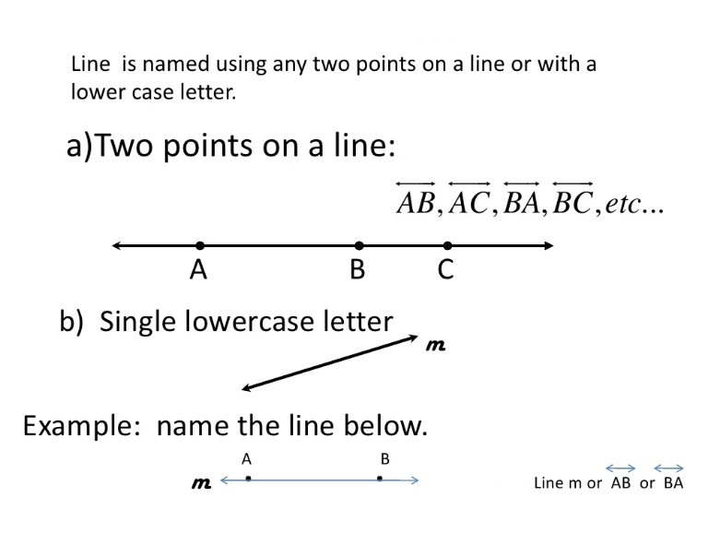
How do we Name a Line?
“What's in a name? That which we call a rose by any other name would smell as sweet.”

Slide 7

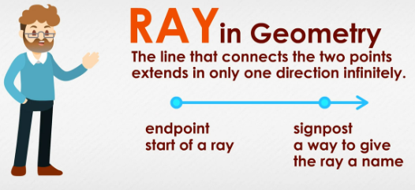
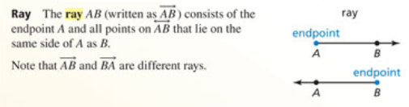
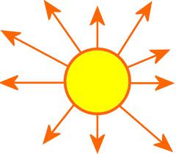
Rays of Sunshine
A ray is part of a line that has a starting point but no end point.

Slide 8

What’s a Line Segment?
A portion or piece of a line with two endpoints. The length is finite and is determined by its two endpoints.

Slide 9

Let’s Practice!
Give another name for
Name all rays with endpoints J.
Are rays EJ and JE the same ray?

Slide 10
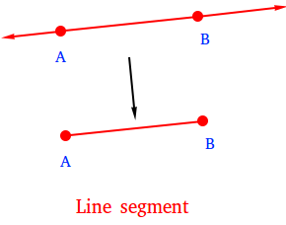
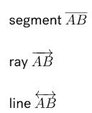
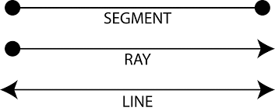
How do you tell the difference between them all?

Slide 11
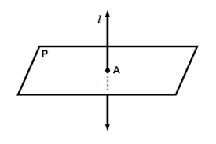
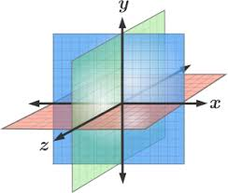
What’s a Plane? It’s plain to see!
A plane is a flat two- dimensional surface which contains points, lines, and segments (they “lie in” the plane)
Planes go on forever, but they are represented by a shape that looks like a floor or a wall (or a parallelogram).

Slide 12
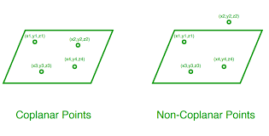
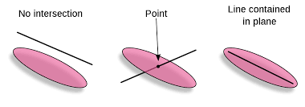

Colinear points: points that lie on the same line.
Coplanar points: points that lie on the same plane.
To name the plane, you can use three points that are not all on the same line.

Slide 13
Let’s Practice!
What is the difference between colinear and coplanar points?
What is another name for Plane M if points A, B, C lie on plane M?
How many points do you need to name a line?

Slide 14
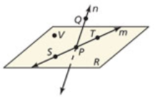
Give two other names for
Give two other names for plane R
Name three points that collinear
Name four points that are coplanar
Give two other names for
Name a point that is NOT coplanar with points Q, S, and T

Slide 15
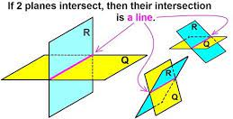
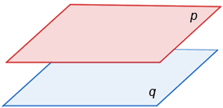
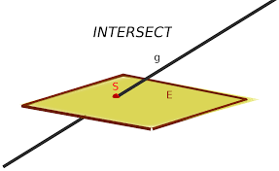
Planes can be in parallel or intersecting!

Slide 16
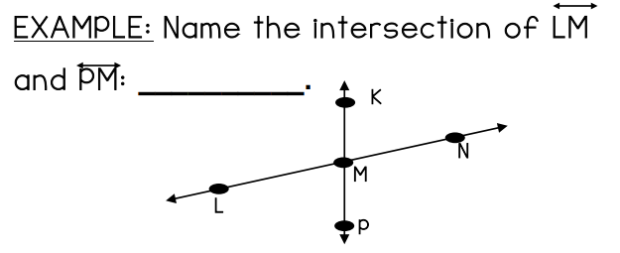
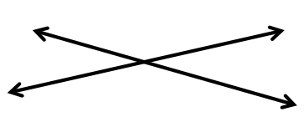
Let’s Practice!
Two lines intersect at _____________________.

Slide 17
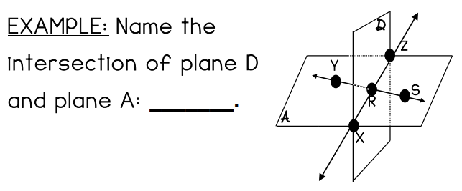
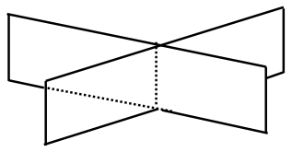
Let’s Practice
Two planes intersect at _________________.
Hint: find two points that are on both planes. These will make up the intersection.

Slide 18
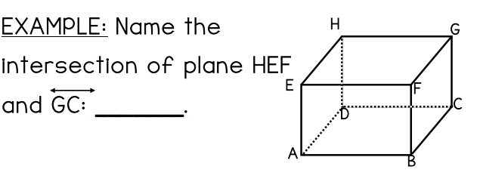
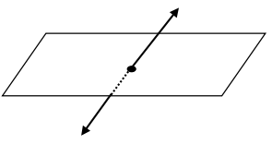
Let’s Practice!
A plane and a line intersect at _________________.

Slide 19
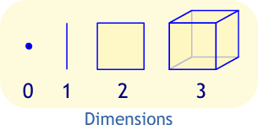
Dimensions!
0 Dimension (point)
1 Dimension (line)
2 Dimension (plane)
3 Dimension (Depth, Breadth, Height)

Slide 20
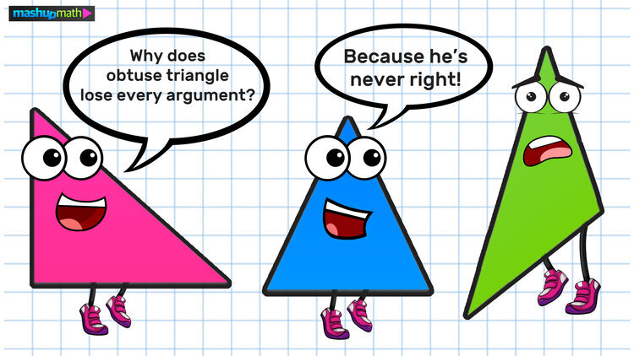
Geometry Worksheet!

Slide 21
